Slide 1
Luggage Recognition using Image Processing
By Rishub Jain
Teacher: Mr. Stueben

Slide 2
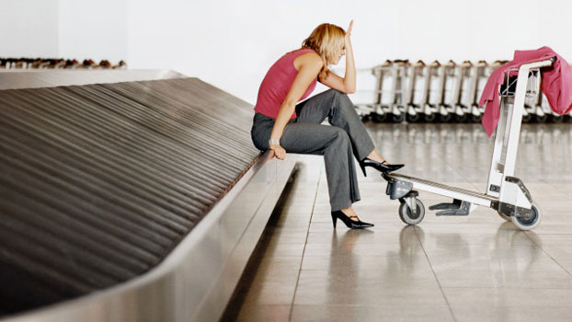
Lost Luggage
Automating the sorting of luggage
Finding luggage once it is lost

Slide 3
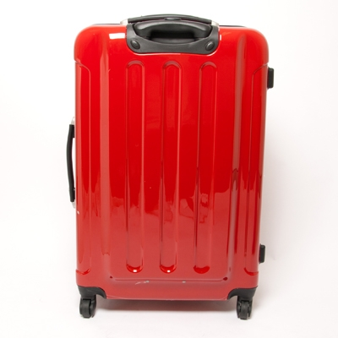
Luggage Characteristics
Dimensions
Dominant colors

Slide 4
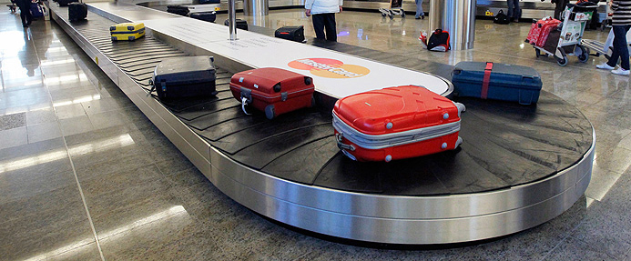
Assumptions
Rectangular luggage
Solid background
Similar lighting
Same distance
from camera
Not tilted

Slide 5
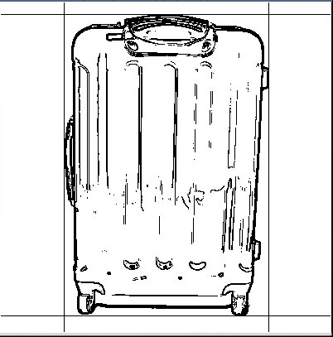
Outline Using Canny Edge Detection

Slide 6
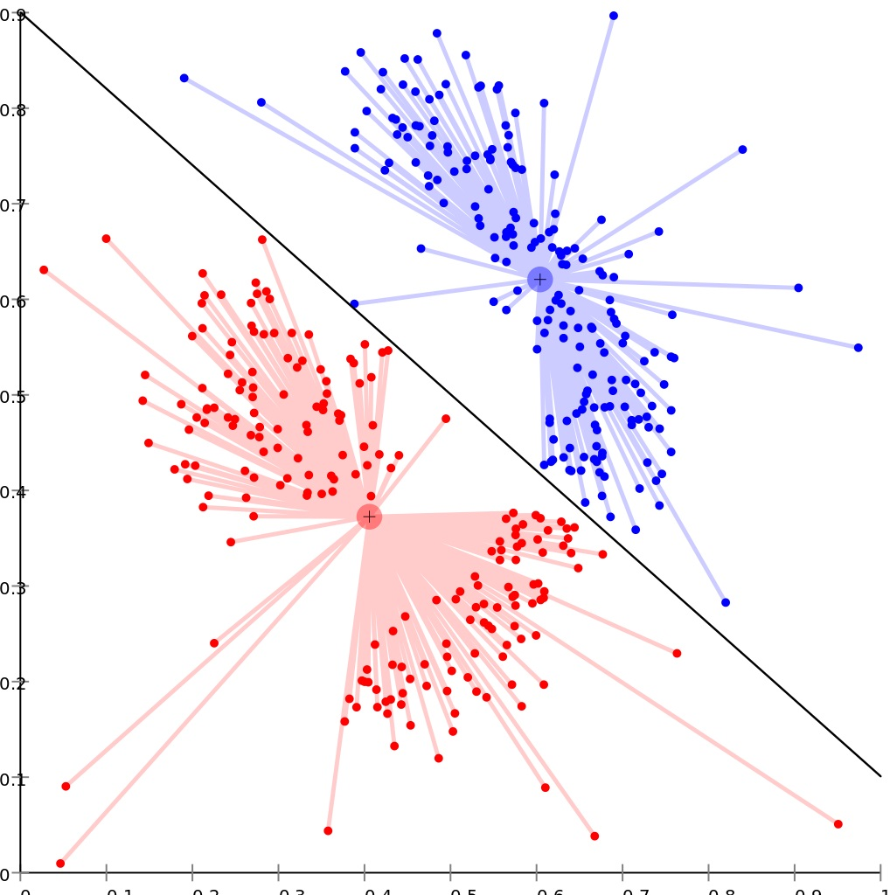
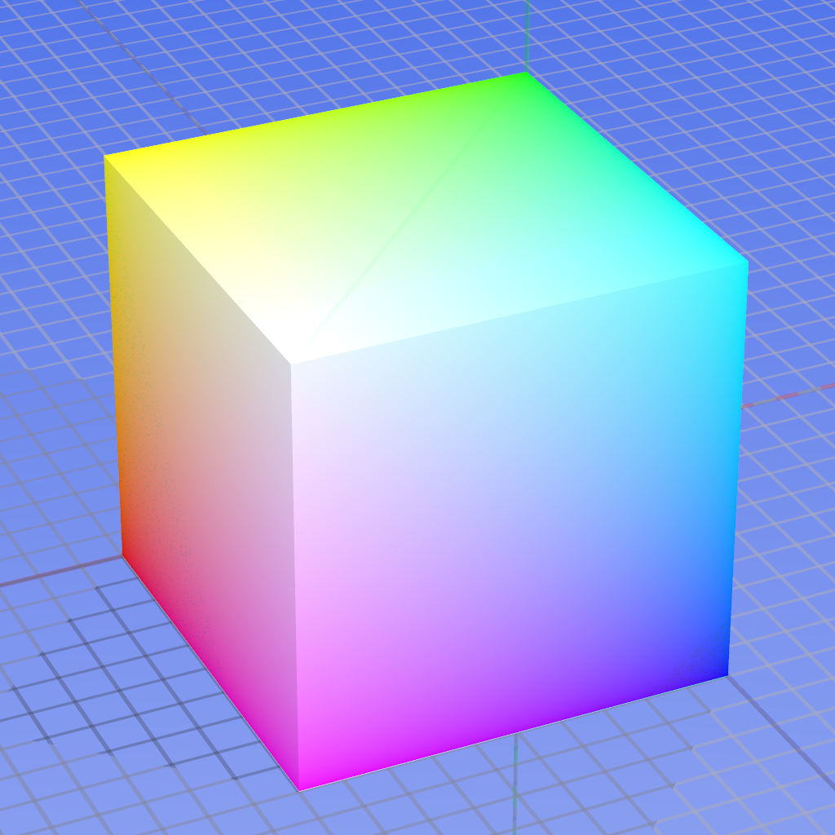
k-means clustering

Slide 7
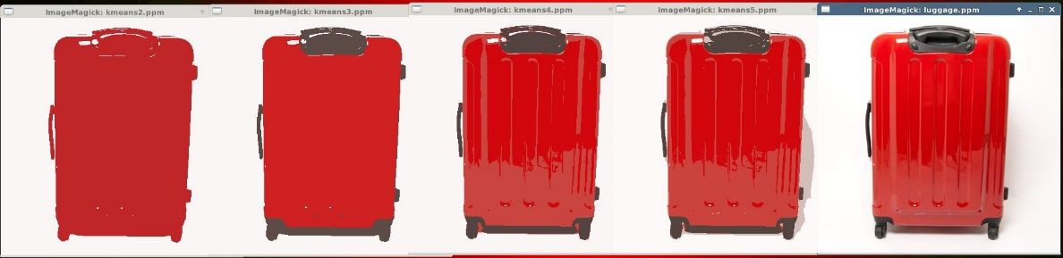
k value (Number of Colors)
2 3 4 5 Original

Slide 8
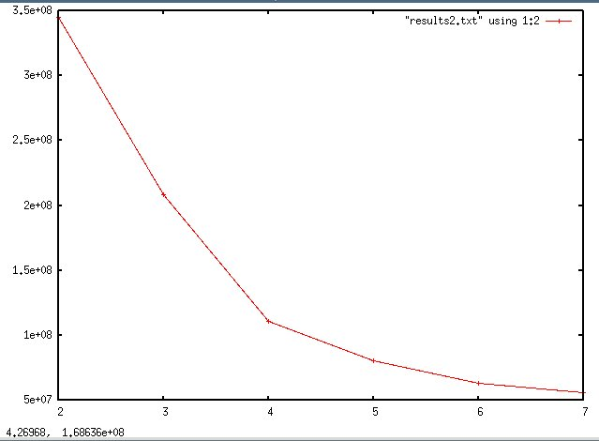
Elbow method

Slide 9
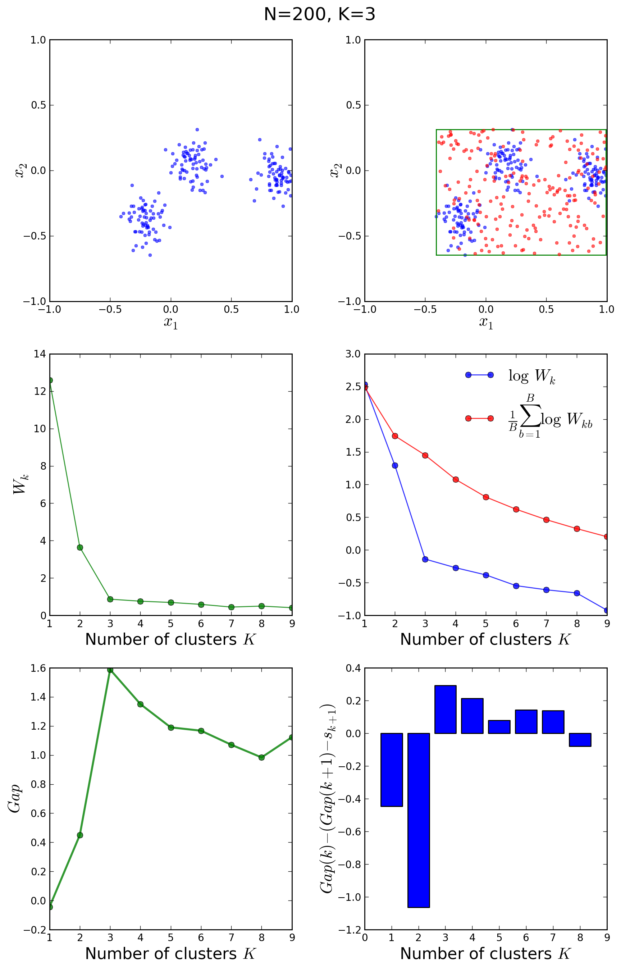
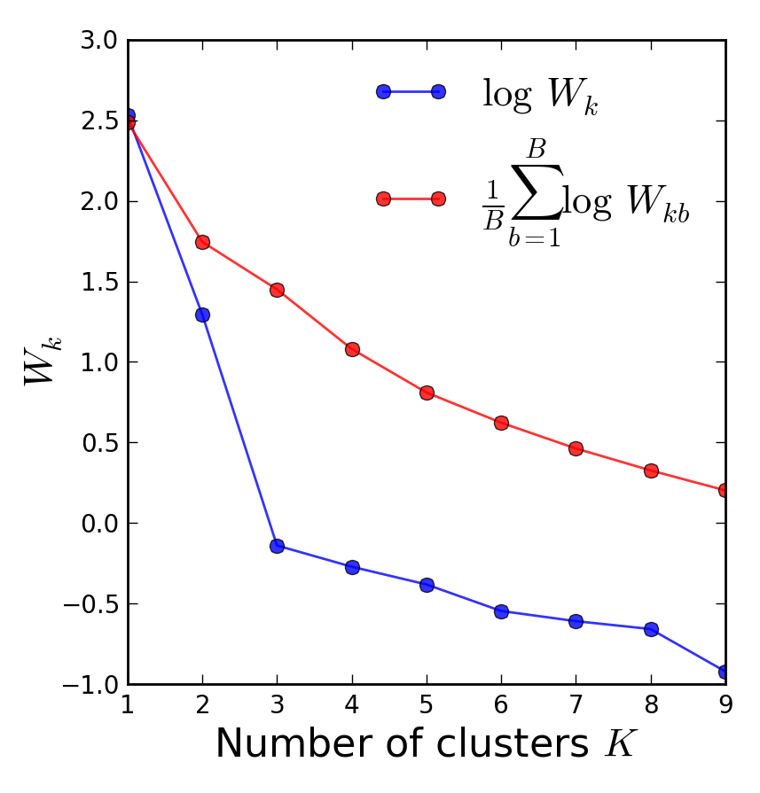
Gap Statistic
Tibshirani et al.

Slide 10
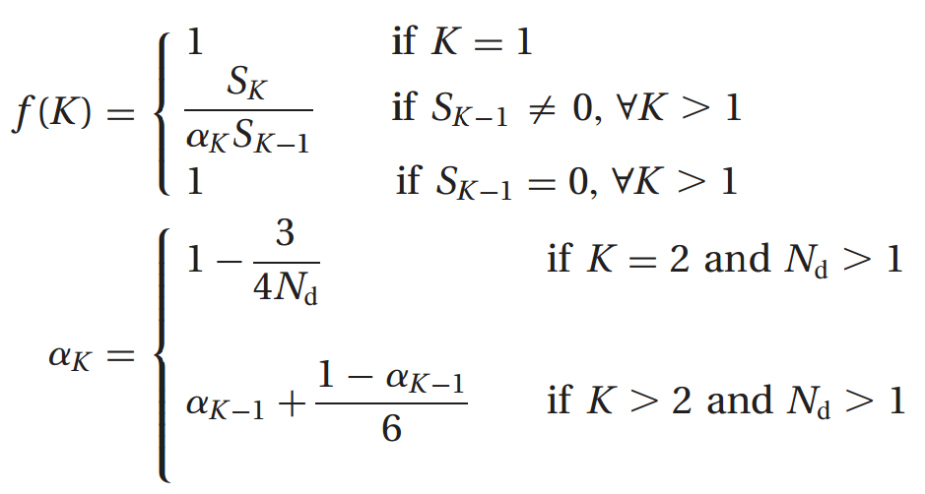
Pham et al.
Fast
Inaccurate

Slide 11
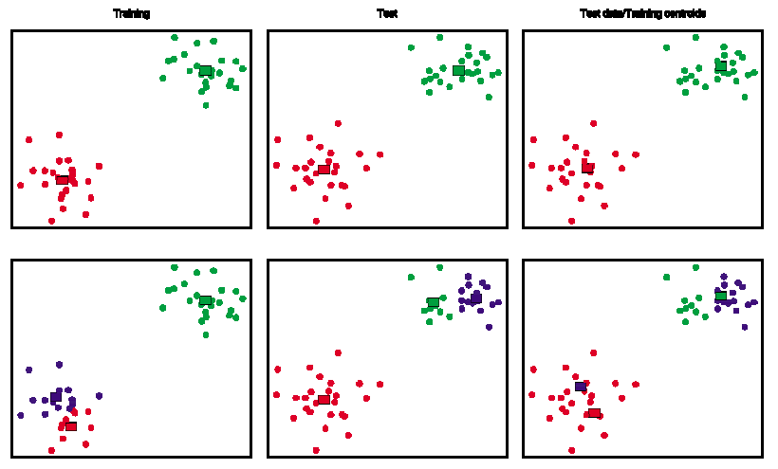
Prediction Strength
Tibshirani et al.

Slide 12
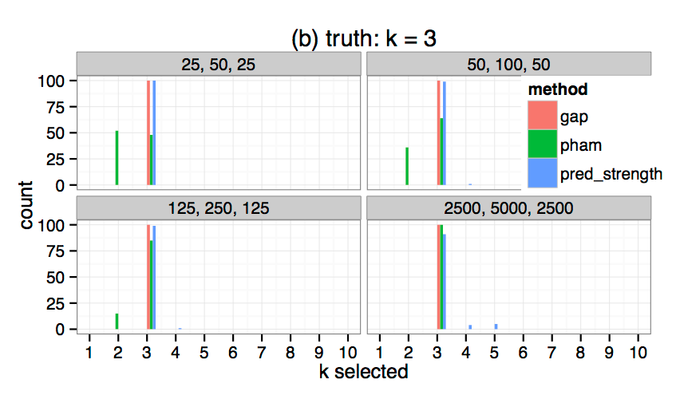
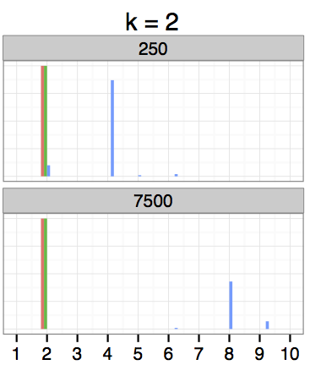
Accuracy Analysis

Slide 13
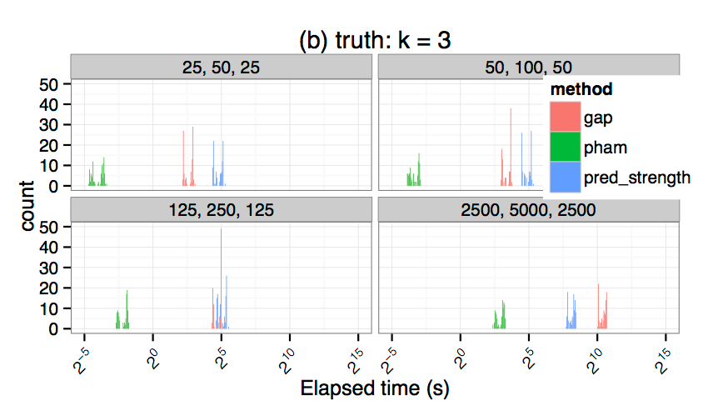
Time Analysis

Slide 14
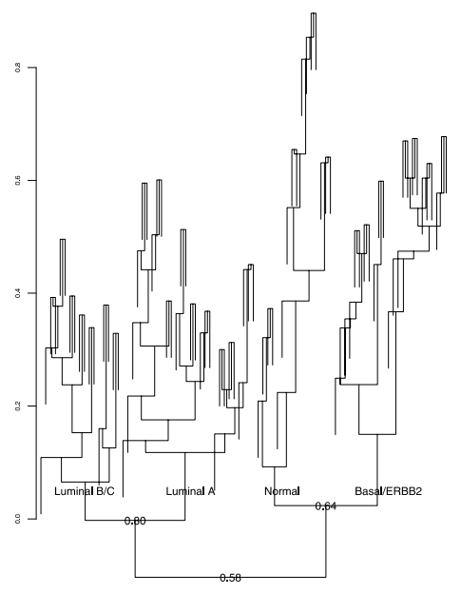
Conclusion
Other methods to explore
Krzanowski and Lai
Contrast statistic
Chose Gap Statistic
Automation not yet practical
Useful in addition to current procedures
Many applications within airports and in other fields

Slide 15
Refrences
http://www.flyafghanistan.us/blog/wp-content/uploads/2014/01/coping-with-lost-luggage-article.jpg
http://www.golfoutletsusa.com/swiss-case-28-red-4-wheel-2-pc-spinner-suitcases.aspx
http://en.wikipedia.org/wiki/RGB_color_model
http://en.wikipedia.org/wiki/Cluster_analysis
https://www.stat.washington.edu/wxs/Stat592-w2011/Literature/tibshirani-walther-prediction-strength-2005.pdf
http://www.ee.columbia.edu/~dpwe/papers/PhamDN05-kmeans.pdf
http://venus.unive.it/romanaz/edami/letture/gap_statistic.pdf
https://haroldpimentel.wordpress.com/2014/12/29/optimal-k-when-theres-no-cluster-gap-vs-pham-part-i/
https://haroldpimentel.wordpress.com/2015/01/22/the-power-of-randomness-pham-vs-gap-part-ii/
https://datasciencelab.wordpress.com/2014/01/21/selection-of-k-in-k-means-clustering-reloaded/
https://datasciencelab.wordpress.com/2013/12/27/finding-the-k-in-k-means-clustering/

